Slide 1
Good morning!

Slide 2
SLAP THE BOARD

Slide 3
Thursday,November 09th,2017
Unit 8: What are you reading?
Lesson 2 – P1, 2, 3

Slide 4
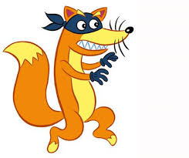
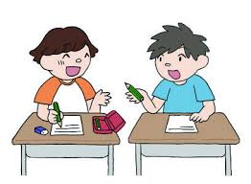
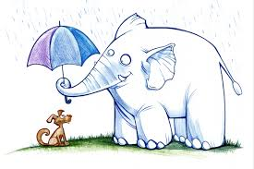
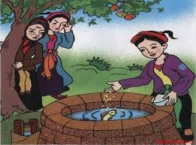
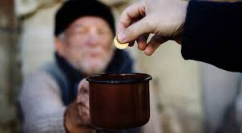
I-Vocabulary
Nhân vật chính
1.Main character :
E.g: Mai An Tiem is the main character of the story of Mai An Tiem.
2. Borrow:
Mượn
2. Generous:
Rộng rãi, hào phóng
3.Kind:
Tốt bụng
4.Hard-working:
Chăm chỉ
5. Clever:
Khôn khéo, lanh lợi
6. Gentle
Dịu dàng, lịch thiệp

Slide 8
LUCKY NUMBER
1
2
3
4
5
6

Slide 9
1. What’s _______like? ( 200 point )
An Tiem
He’s hard – working.
An Tiem / hard – working

Slide 10
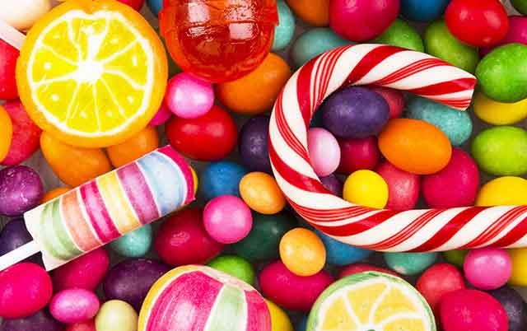
LUCKY NUMBER!!!
(300 points)

Slide 11
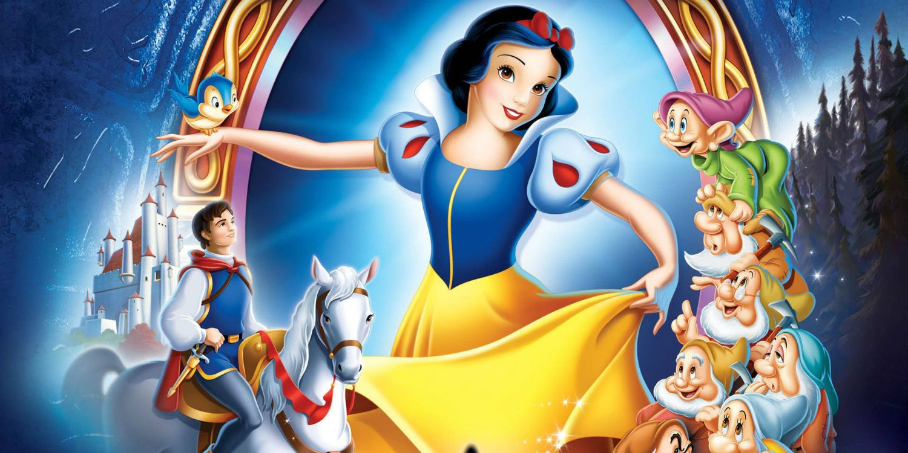
3. What ___________like? ( 300 point )
Snow White
She’s Kind.
Snow White /Kind

Slide 12
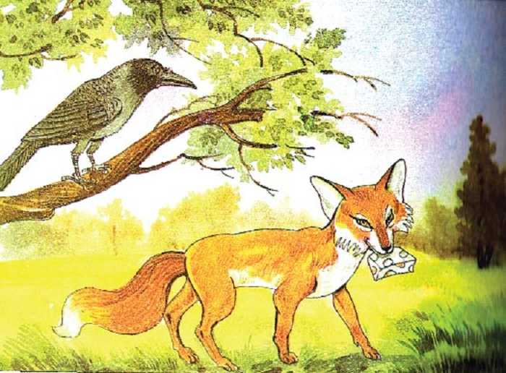
4. What’s _______ like? ( 250 point )
The Fox
It’s clever.
The Fox / clever.

Slide 13
LUCKY NUMBER!!!
(300 points)

Slide 14
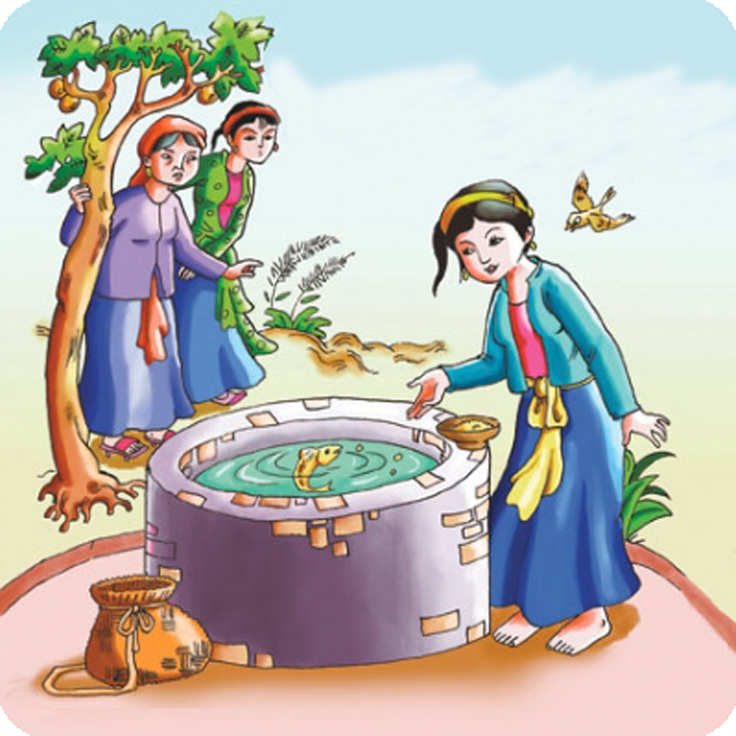
6. What’s ___ like? ( 350 point )
Tam
She’s gentle.
Tam / Gentle

Slide 16
Homework
-Do exercises on workbook. -Prepare next lesson.

Slide 17
Thank you
for your attention!
Good bye!

